Slide 1
Hypothetical situation in the past and regrets
24. Third Conditional

Slide 2
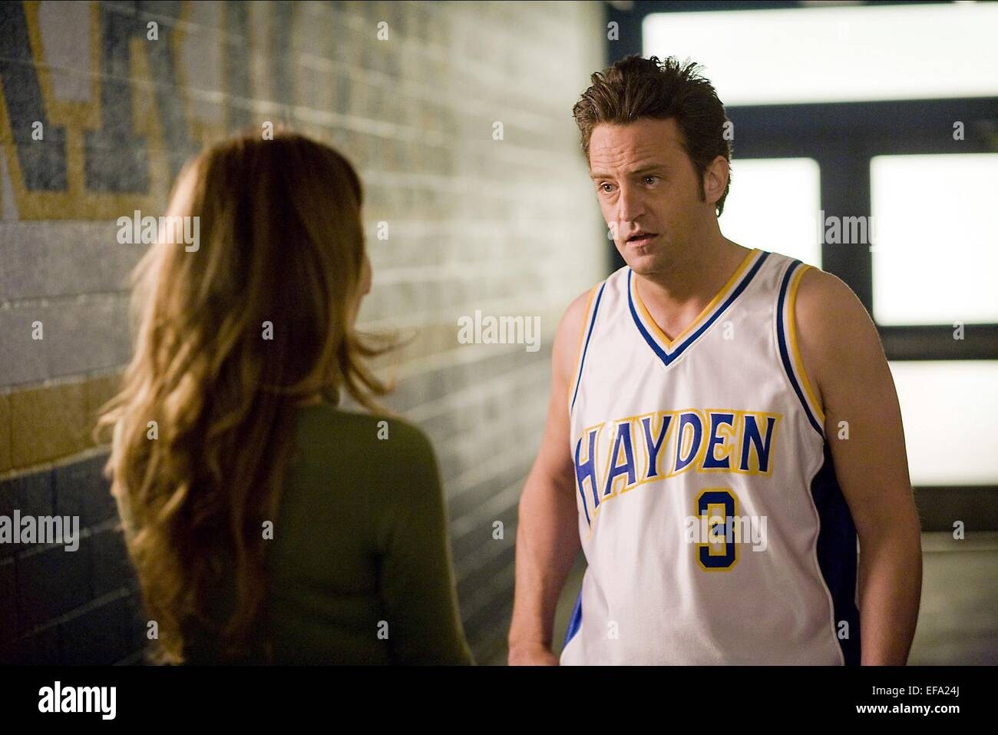
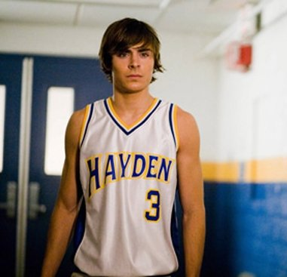
Past situations
If you had studied another career in school, what do you think your life would be like now?
What would you have said to someone important in your life if you had another chance to speak to them now?
What regrets do you think you might have in the future if you don’t make certain decisions now?
Notes:
https://www.forbes.com/sites/ericjackson/2012/10/18/the-25-biggest-regrets-in-life-what-are-yours/?sh=5b53beb36488

Slide 3
Third conditional
If | Subject | had | Past participle | complement | Subject | Would / Could / Might | have | Past participle | complement
If | I | had | eaten | more | I | would not | have | been | hungry
We use the Third Conditional to talk about past conditions that can never be fulfilled because the time has already passed.
We use the Past Perfect Simple in the conditional clause and would have + past participle in the result clause.
If he hadn’t been late, he would have helped Mary. (He was late, so he could not help her)
They wouldn’t have been late if the bus had come. (But the bus didn’t come, so they were late.)
Notes:
https://www.perfect-english-grammar.com/third-conditional-exercise-1.html

Slide 4
Complete the sentences
If | Subject | had | Past participle | complement (optional) | Subject | Would / Could / Might | have | Past participle | complement (optional)
If | I | had | studied | harder
 |  |  |  |  | she | would | have | been | on time
If | I | had | taken | the advice
If | he | had | won | the lottery
 |  |  |  |  | we | would not | have | gotten | lost
If | it | had | rained | that day
 |  |  |  |  | you | could | have | gone | to the party
If | I | had | known
 |  |  |  |  | I | might | have | avoided | the same mistake
If | we | had | checked | the time

Slide 5
Third conditional
We can use might have and could have instead of would have in the result clause of a third conditional sentence, with a slight change in meaning.
If he had had more money, Tom might have bought the MP4. (There is a possibility that he would have bought it.)
If he had had more money, Tom could have bought the MP4. (He would have been able to buy it.)
would – more definite plan
could – had / didn’t have the ability to do it

Slide 6
Complete the sentences with the correct form of the verbs.
If I _____ (not shop) around, I _____ (not find) this special offer.
Ken _____ (give) you good technical advice if you _____ (speak) to him.
I _____ (not be) so unhappy with my new computer if I _____ (take) your advice.
Moira _____ (prepare) a spreadsheet for you if you _____ (ask) her for help.
If we _____ (have) Internet connection, we _____ (surf) the Net for special offers.
They _____ (buy) a cordless mouse if they _____ (not spend) all their money on a DVD burner.
If their computer _____ (not crash), they _____ (not have) to buy a new hard drive.
Larry and Michael _____ (take) this word processing course if they _____ (sign up) on time.
Holly _____ (leave) Heff if she _____ (have) the opportunity.
If I _____ (practice) in my childhood, I _____ (be) a great performer.
Notes:
hadn’t shopped, wouldn’t have found
would have given, had spoken
might not / wouldn’t have been, had taken
would have prepared, had asked
had had, could have surfed
might have / could have bought, hadn’t spent
hadn’t crashed, wouldn’t have had
could have taken, had signed up
Would have left, had had
Had practiced, would have been

Slide 7

What would have happened?
If Europeans hadn’t come to America…
If we hadn’t discovered vaccines…
If we had gone to Mars and not the Moon…
If we hadn’t created the atomic bomb…
If we had discovered a clean renewable energy source…
If we had invented a cure for all illnesses…

